Slide 1



Comprehensive Inventory & Supply Chain Optimization
Project Summary Based on 2016 Data Analysis
Data-Driven Strategy
Transformed inventory planning from reactive to proactive using advanced analytics.
End-to-End Optimization
Aligned sales, procurement, and supplier management for efficient operations.
Proven Methodologies
Applied SARIMA, ABC analysis, EOQ, and lead time variability for tactical insights.
Notes:
This project marked a significant shift in how inventory and supply chain decisions were made—leveraging historical data, robust forecasting models, and supplier performance metrics. Our analysis enabled a more structured, efficient approach to stock and vendor management. From forecasting daily demand for high-volume brands to classifying 7658 brands by value, this work established a comprehensive toolkit. Additionally, by quantifying delivery lead time variability and integrating it into reorder decisions, we built a foundation for leaner and smarter inventory control. This deck outlines how each step contributed to measurable improvements and provides actionable strategies for future implementation.

Slide 2
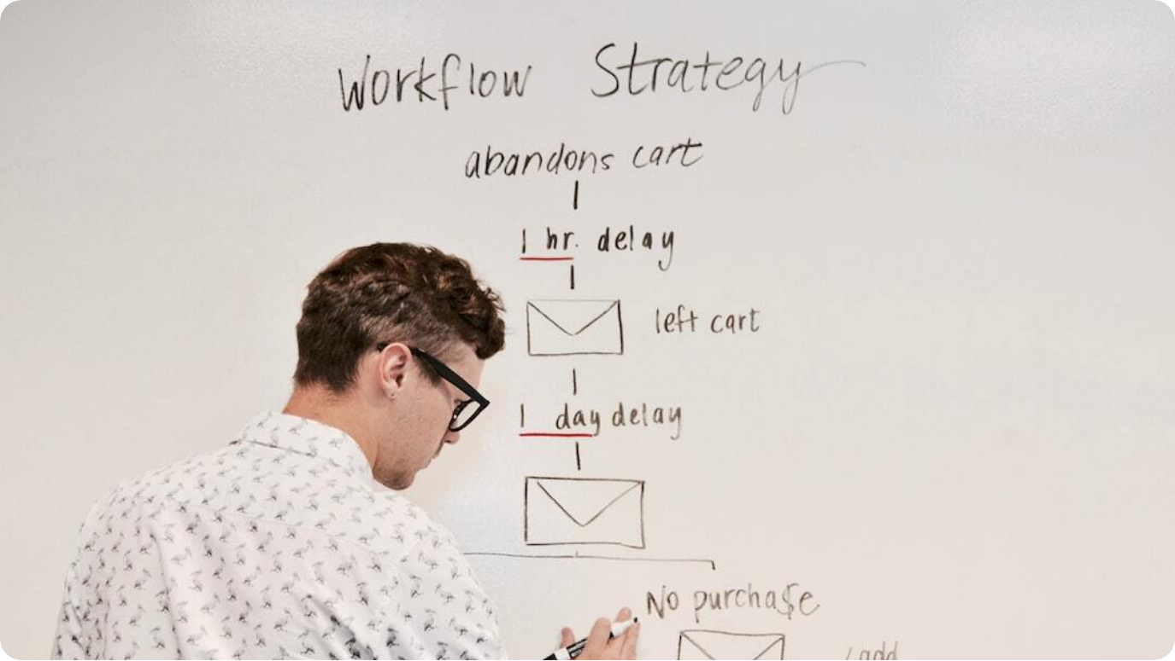
Project Overview & Goals
Transforming Inventory & Supply Chain via 2016 Data Insights
Inventory Optimization: Applied data classification and modeling to determine ideal reorder levels across categories.
Supplier & Sales Analysis: Evaluated top brands, vendor reliability, and delivery consistency for actionable procurement planning.
Process Efficiency: Transitioned to proactive inventory strategy by integrating EOQ, ROP, and forecasting models.
Notes:
Our project began with a clear mission: to overhaul the existing stock management approach using actual operational data from 2016. The goal was to reduce waste, avoid stockouts, and improve alignment between sales, inventory, and supplier activities. Using brand-level sales analytics, we developed forecasting models and reorder strategies that brought structure and predictability to daily operations.
We didn’t stop at sales. We dissected purchase data to identify vendor behavior, calculating both average and variability in lead times. This enabled us to quantify reliability and feed it into safety stock decisions. The result? Inventory aligned with real-world supplier behavior and market demand.
This slide outlines the foundational goals that guided each of the analytical tasks, ultimately laying the groundwork for a smarter, leaner supply chain operation.

Slide 3



Demand Forecasting with SARIMA
Accurate Daily Sales Prediction for Brand 8111
Forecasting Methodology
Applied SARIMA model to 2016 daily sales data to identify trends and seasonal patterns.
Forecast Output
Generated time-series predictions enabling demand-aligned inventory planning.
Business Value
Forecasts facilitate proactive ordering and minimize stockouts or overstock.
Notes:
One of the foundational elements of inventory optimization is predicting demand with precision. We used the Seasonal AutoRegressive Integrated Moving Average (SARIMA) model, a time-series forecasting approach, to analyze daily sales data for Brand 8111. This model captured both trend and seasonal behavior, producing forecasts that align closely with actual demand cycles.
With the forecasts in place, procurement can shift from reactive replenishment to preemptive stock control. This means fewer surprises, smoother supply, and reduced carrying costs.
Ultimately, accurate demand forecasts like these ensure that we can deliver what customers need, when they need it—without over-investing in inventory.

Slide 4



ABC Analysis: Brand Categorization
Value-Based Inventory Segmentation (2016 Data)
A-Items: High Value
1502 brands (~19.6%) accounted for 79.99% of sales value; require rigorous controls.
B-Items: Moderate Value
1813 brands (~23.7%) represented 15.00% of value; moderate control required.
C-Items: Low Value
4343 brands (~56.7%) contributed only 5.00% of value; minimal oversight needed.
Notes:
ABC analysis is a powerful method for segmenting inventory based on contribution to total sales. Using the Pareto Principle, we categorized over 7,600 unique brands into A, B, and C classes.
A-items, though few in number, drive the majority of sales and thus require the most attention—tight forecasting, frequent replenishment, and careful stock monitoring. B-items fall into a middle tier, while C-items, the most numerous but least valuable, can be managed with simpler policies to save resources.
This approach allows us to tailor inventory strategies per class—maximizing service level where it matters most and streamlining effort where returns are low.

Slide 5
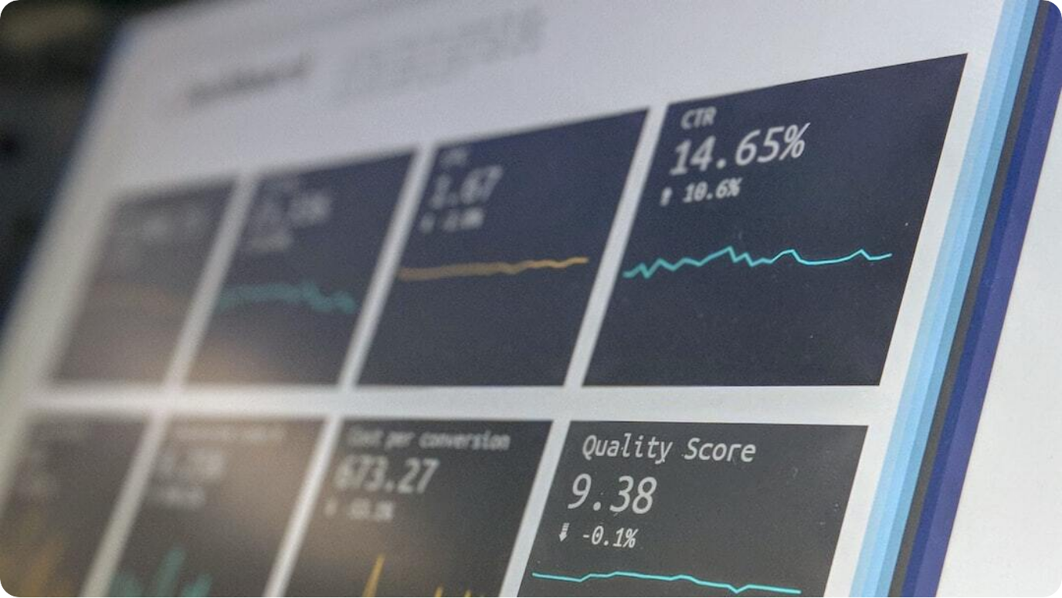
Supplier Performance Analysis
Insights from Purchase & Invoice Data (2016)
Top Vendor Identification: Ranked suppliers by purchase volume and spend (e.g., DIAGEO, MARTIGNETTI, JIM BEAM).
Payment Term Analysis: Analyzed adherence to terms—most suppliers averaged 35–37 days to payment.
Reliability Metrics: Evaluated supplier delivery consistency and timeliness via lead time standard deviation.
Notes:
Vendor relationships are pivotal to supply chain resilience. We used two key datasets—purchase orders and invoices—to identify top suppliers by purchase volume and value. Notable leaders included DIAGEO NORTH AMERICA INC and MARTIGNETTI COMPANIES.
Beyond spend, we examined financial discipline—how quickly invoices were settled. Most suppliers were paid within a tight 35–37 day window, indicating consistency and strong vendor terms.
Finally, we analyzed delivery lead time variance to measure operational reliability. Vendors with low variability are more predictable and allow lower safety stock levels, directly reducing inventory costs.
This analysis empowers more strategic sourcing and prioritization of reliable partners.

Slide 6


Delivery Lead Time Consistency
Supplier Reliability Through Variability Metrics
Lead Time Definition
Calculated delivery lead time using order and receipt dates for accuracy.
Standard Deviation Analysis
Assessed delivery variability to determine predictability of suppliers.
Visual Insights
Used scatter plots to highlight variance trends among top vendors.
Notes:
Consistency in supplier delivery is a silent driver of inventory efficiency. To capture this, we clarified data semantics—using PODate as the order placement and ReceivingDate as actual receipt.
By calculating standard deviation alongside average delivery lead time, we pinpointed which vendors were consistently on-time versus erratic. A vendor with high lead time variability poses a hidden risk—requiring higher safety stock and tying up capital.
We visualized this using scatter plots, which made patterns clear: some top vendors, despite high volume, showed poor consistency. These insights offer direct levers to either improve reliability through negotiations or diversify sourcing to reduce operational exposure.

Slide 7

Inventory Optimization: EOQ & ROP
Balancing Cost & Availability via Analytical Models
Economic Order Quantity (EOQ): Calculated optimal order size to minimize total inventory costs.
Reorder Point (ROP): Determined reorder threshold considering demand rate and lead time.
Incorporated Safety Stock: Used lead time variability data to define appropriate buffer levels.
Notes:
Inventory management decisions rest on two crucial questions: how much to order and when. For Brand 8111, we answered both using analytical models.
The EOQ model balances ordering and holding costs to find the most cost-efficient order size. Simultaneously, the ROP model signals exactly when to reorder, factoring in average daily demand and supplier lead time.
To prevent stockouts, we included a buffer—safety stock—based on each supplier’s delivery variability. This integrated approach ensures inventory is lean, responsive, and resilient.
Applying EOQ and ROP doesn’t just reduce costs—it empowers operations with predictability and precision.

Slide 8

Strategic Recommendations
Actions for Leaner, Smarter Supply Chains
Segmented Inventory Policies: Apply ABC-based controls—tight management for A-items, simple methods for C-items.
Forecast-Driven Replenishment: Integrate demand forecasts into EOQ and ROP to adapt dynamically.
Supplier Risk Management: Work with inconsistent vendors to reduce variability and evaluate JIT feasibility.
Notes:
Insights alone don’t transform operations—action does. From our analysis, several clear recommendations emerged for immediate and strategic improvements.
First, segment inventory using the ABC categories. High-value A-items should receive priority in forecasting, safety stock modeling, and ordering frequency. B- and C-items benefit from simplified processes that save effort without harming service levels.
Second, build forecasting into daily replenishment routines. Let EOQ and ROP evolve with demand trends, ensuring relevance month to month. Third, invest in supplier partnerships. Vendors with volatile lead times must be coached or replaced, especially for mission-critical items.
These recommendations empower a supply chain that is both lean and robust—optimizing cost while safeguarding service.

Slide 9

Project Impact & Road Ahead
Enabling Proactive, Cost-Efficient Supply Chains
Operational Efficiency Gains: Reduced excess inventory and stockouts through precise planning models.
Stronger Supplier Relationships: Used data insights to manage and negotiate with vendors more strategically.
Scalable Analytical Framework: Established methodologies for future demand forecasting and optimization.
Notes:
The culmination of our work lies in the tangible and strategic improvements achieved. First and foremost, inventory planning became significantly more data-driven—cutting down excess stock, reducing stockouts, and boosting turnover rates.
We now engage vendors with clarity—armed with delivery performance and payment behavior analytics, our supplier strategy is informed and tactical. Moreover, we've laid a scalable foundation: models like SARIMA, ABC, EOQ, and ROP can be continually updated with fresh data.
Looking ahead, this project enables transition to more agile methodologies such as JIT or demand-sensing systems. The groundwork is in place for a leaner, smarter supply chain built on evidence, not estimation.

